Slide 1
DATA ANALYSIS PROJECT USING PYTHON
ZOMATO

Slide 2
ABOUT THE PROJECT :
Zomato has average of 17.5 millions monthly transacting customers for food delivery business.
Average monthly active food delivery restaurant partners on Zomato’s platform have also increased by 8.7% year – on – year , from 20800 to 226000 .
So I am create a professional dataset of and analyse the data , perform EDA(exploratory Data analysis) and visualization .
I am perform the following answer of questions :

Slide 3
Perform the following answer of questions in this project
what type of restaurant do the majority of customer order from
How many votes has each type of restaurant received from customers
What are the ratings that the majority of restaurant have received
Zomato has observed the most couples order most of their food online . What is their average spending on each order
Which mode(online – offline) has received maximum rating
Which type of restaurant received more offline order . So that Zomato can provide customers with some good offers

Slide 4
S.NO | Name | Online_order | Book _table | rate | votes | approx_cost(for two people) | Listed_in(type
0 | Jalsa | Yes | Yes | 4.1/5 | 775 | 800 | Buffet
1 | Spice Elephant | Yes | No | 4.1/5 | 787 | 800 | Buffet
2 | San Churro Cafe | Yes | No | 3.8/5 | 918 | 800 | Buffet
3 | Addhuri Udupi Bhojana | No | No | 3.7/5 | 88 | 300 | Buffet
4 | Grand Village | No | No | 3.8/5 | 166 | 600 | Buffet
... | ... | ... | ... | ... | ... | ... | ...
143 | Melting Melodies | No | No | 3.3/5 | 0 | 100 | Dining
144 | New Indraprasta | No | No | 3.3/5 | 0 | 150 | Dining
145 | Anna Kuteera | Yes | No | 4.0/5 | 771 | 450 | Dining
146 | Darbar | No | No | 3.0/5 | 98 | 800 | Dining
147 | Vijayalakshmi | Yes | No | 3.9/5 | 47 | 200 | Dining

Slide 5
Convert the datatype of column - rate
Code :
def handleRate (value):
value=str(value).split("/")
value=value[0];
return float(value)
dataframe["rate"]=dataframe["rate"].apply(handleRate)
print(dataframe.head())

Slide 6
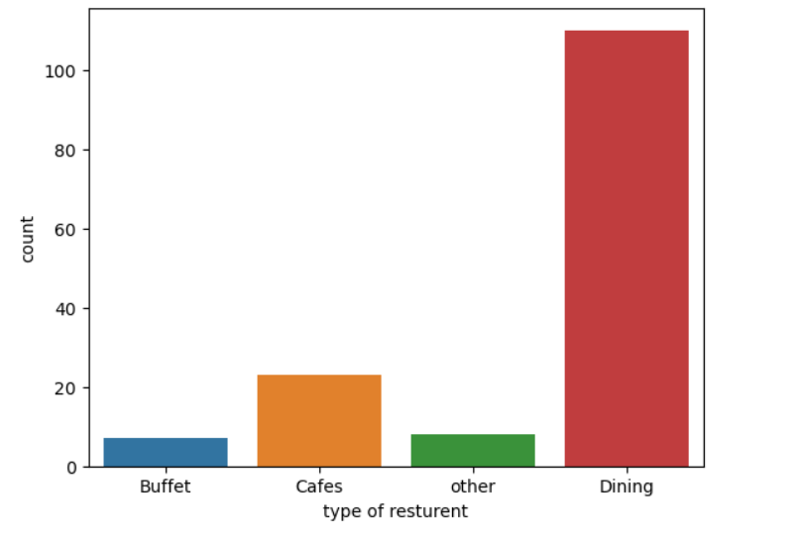
Type of restaurant
1) solution
code:
sns.countplot(x=dataframe["listed_in(type)"])
plt.xlabel("type of resturent")
plt.show()

Slide 7
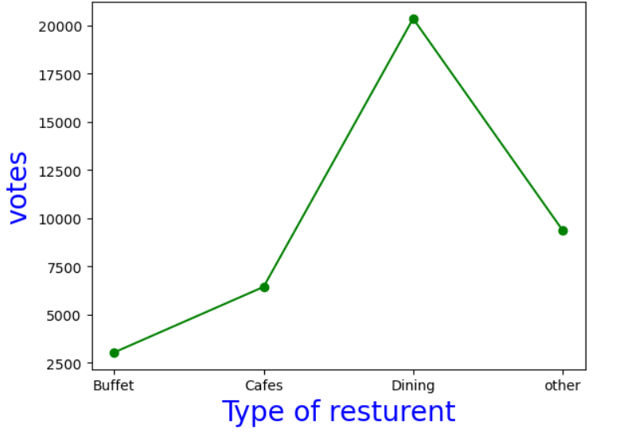
2)Solution
Code:
grouped_data=dataframe.groupby("listed_in(type)")["votes"].sum()
result=pd.DataFrame({"votes":grouped_data})
plt.plot(result,c="green",marker="o")
plt.xlabel("Type of resturent",c="blue",size=20)
plt.ylabel("votes",c="blue",size=20)
plt.show()

Slide 8
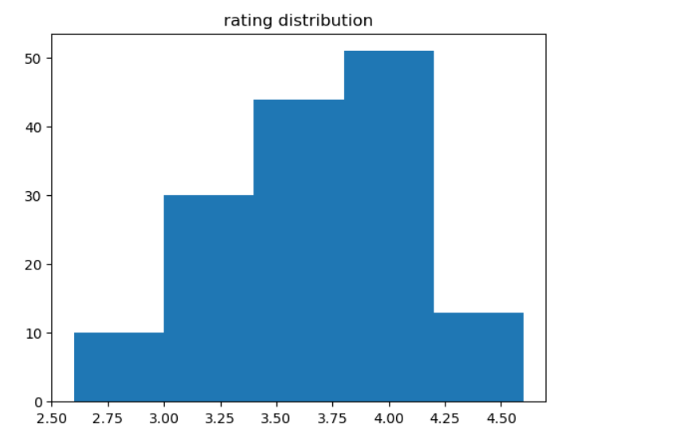
3)Solution
Code:
plt.hist(dataframe["rate"],bins=5)
plt.title("rating distribution")
plt.show()

Slide 9
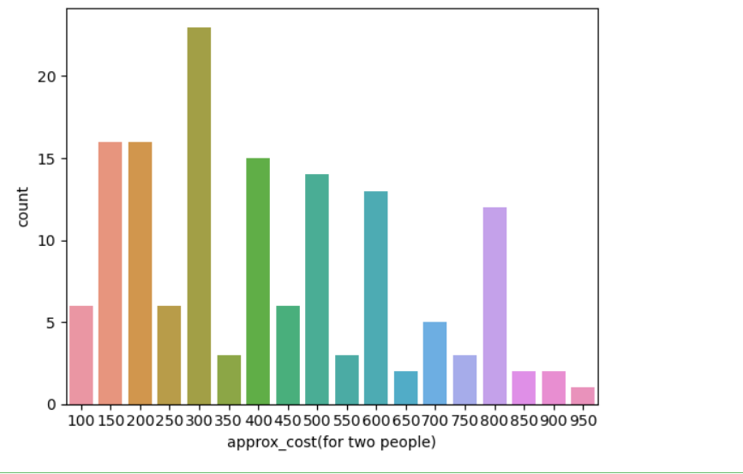
Average order spending by couples
4)Solution
couple_data=dataframe["approx_cost (for two people)]
sns.countplot(x=couple_data)
plt.show()

Slide 10
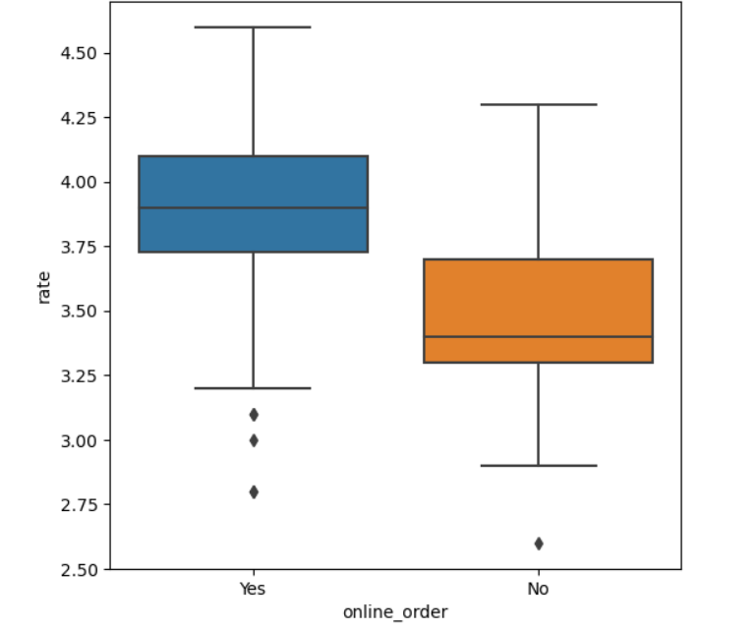
which mode recieves maximum rating
5)Solution
Code:
plt.figure(figsize = (6,6))
sns.boxplot(x="online_order",y="rate”
,data=dataframe)
plt.show()

Slide 11
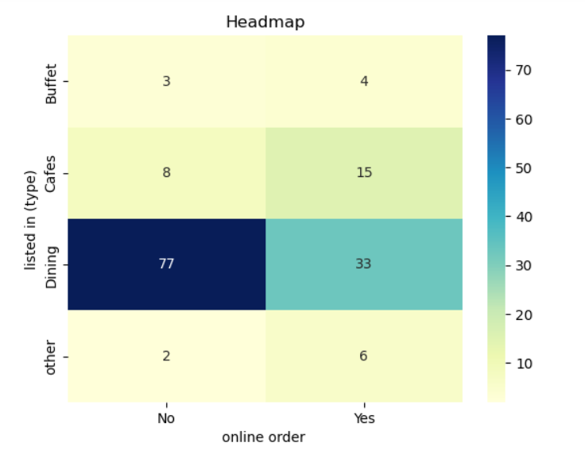
6)Solution
Code:
pivot_table=dataframe.pivot_table(index="listed_in(type)",
columns="online_order",aggfunc="size",fill_value=0)
sns.heatmap(pivot_table,annot=True,cmap="YlGnBu",fmt="d")
plt.title("Headmap")
plt.xlabel("online order ")
plt.ylabel("listed in (type)")
plt.show()

Slide 12
​
​
Canclution
majority of the restaurant falls in dinning category.
majority of the restaurant falls in dinning category.
the majority restaurants received ratings from 3.5 to 4.0.
he majority of couples prefer restaurants with an approximate cost of 300 rupee.
offline order received lower order compering to online order.
Dinning restaurants primarily accept offline orders. Whereas person cafes primarily receive online orders. This suggest that clints prefered placed orders in person a restaurants , but prefer online ordering at cafes.

Slide 13


